Slide 2
Server
Client

Slide 3
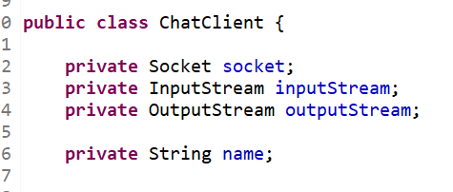
Client
inputStream
outputStream
Socket

Slide 4
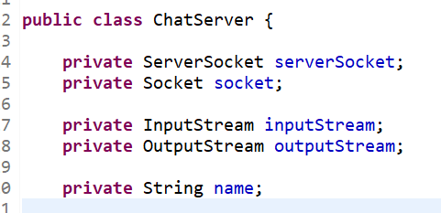
Server
inputStream
outputStream
Socket
ServerSocket
ip주소, port번호,
……

Slide 5


Slide 6
Server
Client
inputStream
inputStream
outputStream
outputStream
ServerSocket
Socket
Socket

Slide 7
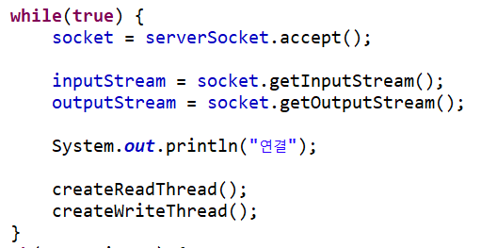
Server

Slide 8
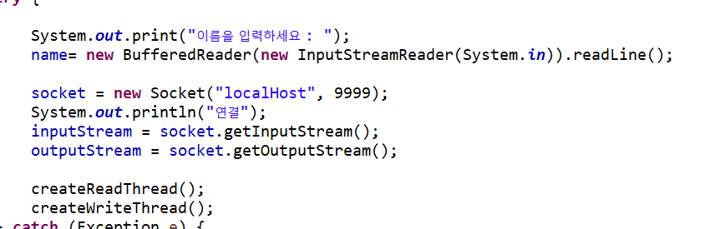
Client

Slide 9
Client
outputStream
Monitor
Socket
inputStream
KeyBoard

